Slide 1
The Trinity Research Education Environment (TREE)
Dr. Laure Marignol
Dean’s Innovation in Teaching Award
Faculty of Health Sciences

Slide 2
Trinity Research Education Environment (TREE)
Dr. Laure Marignol, Discipline of Radiation Therapy, School of Medicine
Address the gaps of traditional research programmes
Exploit digital capabilities of Trinity College
Enhance quality and dissemination outcomes of Trinity student’s research
Dean’s Teaching Award 2015, Faculty of Health Sciences

Slide 3
Trinity Research Education Environment (TREE)
Dr. Laure Marignol, Discipline of Radiation Therapy, School of Medicine
a virtual interactive student-oriented learning environment for research skills development
Transform
Develop
Pilot
24 month
12 month
Disseminate
Invite Head of Departments
Evaluate
6 month
Create Interactive teaching activities
Peer-review
Create an online interface on blackboard
Design a 7 element instructional structure
Prepare core teaching material
Dean’s Teaching Award 2015, Faculty of Health Sciences

Slide 4
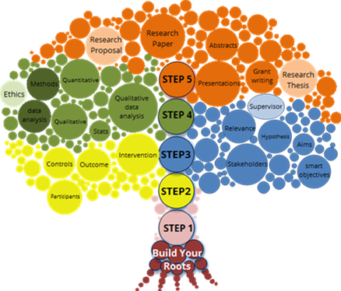
Trinity Research Education Environment (TREE)
Dr. Laure Marignol, Discipline of Radiation Therapy, School of Medicine
Structure
5 research steps – (The trunk)
Step 1: What is this topic about? - Acquire knowledge
Step 2: Focus, please! - The research question
Step 3: What’s in it for me? - Aims, objectives, relevance and importance
Step 4: I can do it! - Research methods and statistics
Step 5: Put it all together – Disseminate!
30-40 min Interactive teaching material
Introduce / prepare study
Dean’s Teaching Award 2015, Faculty of Health Sciences

Slide 5
Trinity Research Education Environment (TREE)
Dr. Laure Marignol, Discipline of Radiation Therapy, School of Medicine
Structure
Customizable and expandable interactive activities – (branches and leaves)
Apply, Recall and Extend elements
Dean’s Teaching Award 2015, Faculty of Health Sciences

Slide 6
Trinity Research Education Environment (TREE)
Dr. Laure Marignol, Discipline of Radiation Therapy, School of Medicine
The TREE is a dynamic teaching tool.
The module coordinator will be able to rely on the core components to teach their students the key research concepts but have opportunities to customise activities and examples to tailor the TREE to their field.
Dean’s Teaching Award 2015, Faculty of Health Sciences

Slide 7
Trinity Research Education Environment (TREE)
Dr. Laure Marignol, Discipline of Radiation Therapy, School of Medicine
The TREE is a dynamic learning tool.
Students accessing the TREE will be able to identify the skills relevant to their location on the 5-step research journey and track their progress to completion.
Dean’s Teaching Award 2015, Faculty of Health Sciences

Slide 8
Trinity Research Education Environment (TREE)
Dr. Laure Marignol, Discipline of Radiation Therapy, School of Medicine
Using the TREE – What’s next?
TREE blackboard resource to be made available to RT students
Research skills taught in SF
JS and SS Students to access the content to revise / improve research skills
Anyone interested in access the TREE / pilot it with their students should contact me
Use own research module shell on blackboard to upload resources, assessment etc..
Guide students to use the TREE to learn specific aspects
Reduce contact hours
Dean’s Teaching Award 2015, Faculty of Health Sciences

Slide 9
Trinity Research Education Environment (TREE)
Dr. Laure Marignol, Discipline of Radiation Therapy, School of Medicine
Using the TREE
Step- concept piloted within our Discipline for several years
Online content used this year as part of research module for online Msc in Advanced Radiotherapy Practice
Weekly release of material
Additional activities uploaded
Weekly tutorial
Content now merged into the TREE and ready to be piloted.
Dean’s Teaching Award 2015, Faculty of Health Sciences

Slide 10
Trinity Research Education Environment (TREE)
Dr. Laure Marignol, Discipline of Radiation Therapy, School of Medicine
Impact
Benefit all those involved in research training within College
Enhance our student’s learning experience
Enhance Trinity’s research outcomes
Dean’s Teaching Award 2015, Faculty of Health Sciences

Slide 11
Anyone interested in viewing / using the TREE is welcome to contact me!

